Slide 1
Magnus Effect on a Cylindrical Airfoils
Zhangxi ‘Jesse’ Feng, Simon Popecki, James Skinner
Advisor - Samuel Cole
May 5th, 2017

Slide 2
Statement of purpose
Experimentally observe the effect of a cylinder’s radius on the lift force
Evaluate how wind speed will affect the resulting lift force at various rpms

Slide 3
Background

Slide 4

Experimental Methods
$F=$

Slide 5
Results and Discussion
The Stella Airfoil was

Slide 6
Results and Discussion
The Budweiser Airfoil was

Slide 7
Results and Discussion
The Quaker Oat Airfoil was

Slide 8
Summary of observations

Slide 9
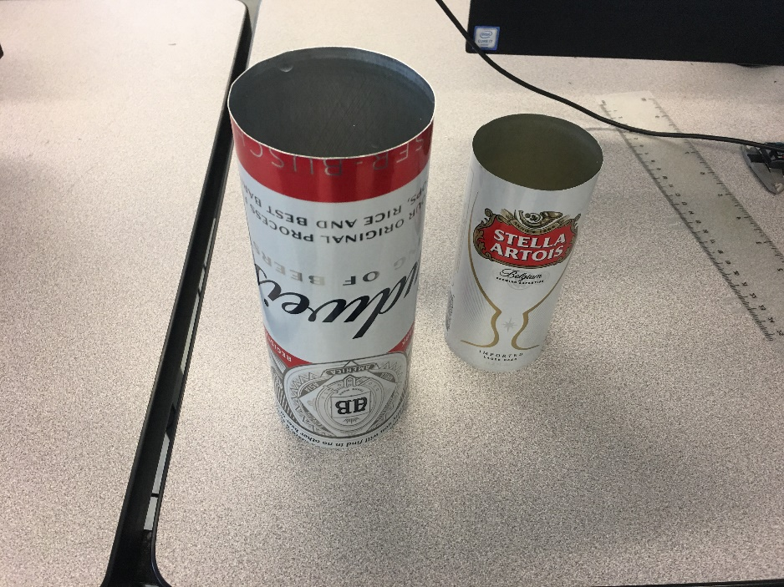
Acknowledgements
Professor Todd Gross, Ivaylo Nedyalkov, and Samuel Cole for their assistance with our experiment
No thanks to the difficulty delivered to us by the force balance
Additionally, Evan Grissino for helping to make it possible to create our airfoils

